Slide 1

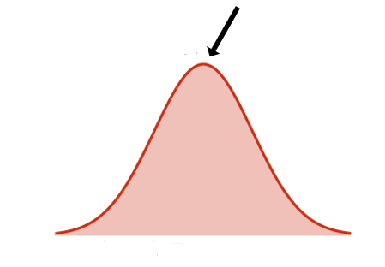
Creative Enough
Raymond Dolan
Alejandra Garza

Slide 2

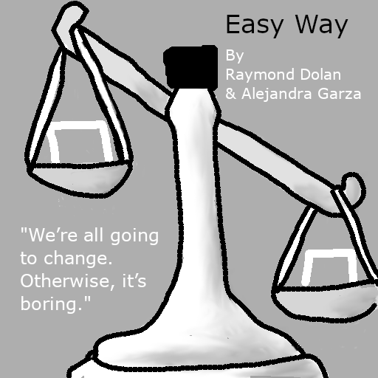
Original Idea
Easy Way - "We’re all going to change. Otherwise, it’s boring."
Two goals in every stage
Game map is bigger than the grid size
Getting player to realize there is more to the grid than they see, getting them to seek out the more fulfilling goal

Slide 3
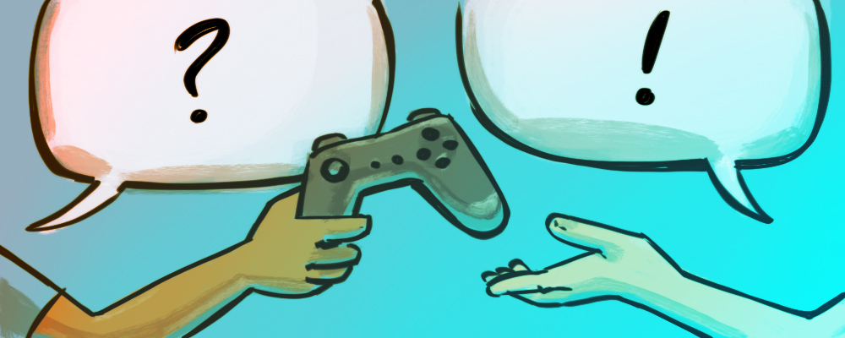
First Playtest
Everyone remembered the presentation
Liked the camera
Camera was a bit “tight”
Goals should have different sounds ?
Exploring was fun

Slide 4

Survey
First introduction of second goal was “elegant”
Obvious goal becomes uninteresting after the first level
Field of view should be increased
“Enjoyed the simplicity of the game”
Easy to understand the mechanics
Color pallette was fitting
Most understood the theme of the game

Slide 5
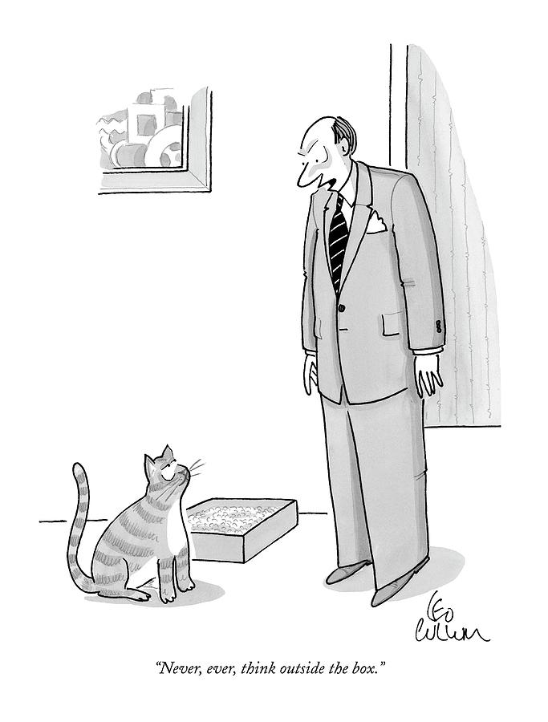
New Idea
“Outside the Box” - Boxes were made to be broken.
Encouraged the player to “think outside the box” by having them explore the level
Added an “eating” mechanic that allowed the player to break “walls”
Adjusted camera movement

Slide 6

Class Critique
Border around grid is distracting
Liked how the eating mechanic was implemented
Need to change how it was introduced
Wisdom was clear

Slide 7
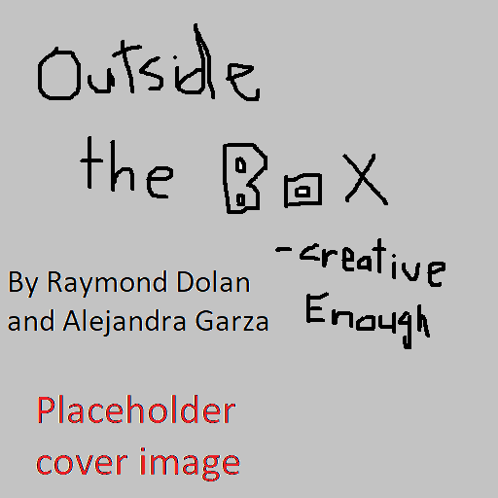
Second Playtest + Survey
No camera complaints
Most pressed space
suggested to make “Enter” the same as space
Moving sound was annoying
everything else was “fitting”
Theme of game was very clear
Liked border around grid
Eating mechanic was understood very easily
Ending was “disappointing”

Slide 8
Final Version
Got rid of clicking sound
Kept the border around the grid the same
Added background music that evolves as the game progresses
Made a special musical cue for ending
Added new level
Made our cover image

Slide 9

DEMO

